Slide 1
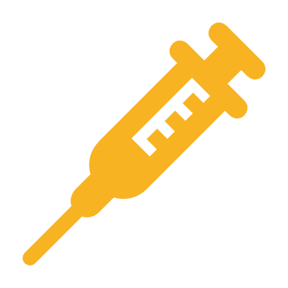
COVID-19 Vaccine Allocations
Yuang Geng, Lawrence Hua, Carl Kogstrom, Mike Provosty, Jack Tian

Slide 2
Process
Trained Flutes model
Gathered Data
56 Tracts + Employment from 2020 US Census
Made Predictions on Alachua County

Slide 3
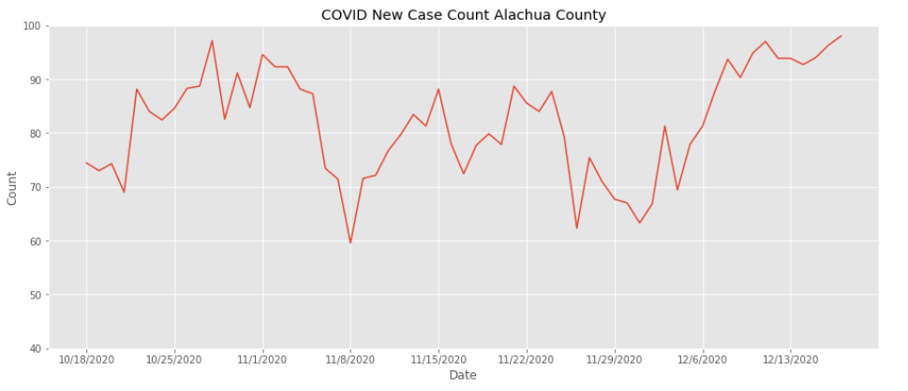
Notes:
CDC covid rates in Alachua county from 2020

Slide 4
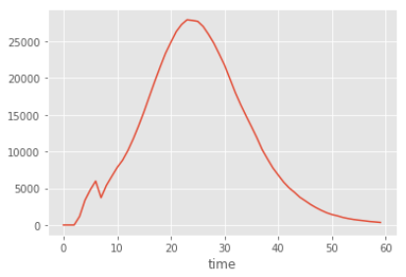
Default FluTEs simulation

Slide 5
Summary
Original Idea
Use Reinforcement Learning to tune hyperparameters to make predictions
What we learned
Reinforcement Learning techniques are overkill for the problem we are trying to solve.
Overfit hyperparameters
Notes:
Hyperparameters are parameters that are used to set bounds on how the model learns.

Slide 6
Next steps, how can we do better?
Tune hyperparameters using Deep Learning (DL)
Deep learning is based on data/patterns
Why?
Predictions are skewed due to the nature of Reinforcement Learning

Slide 7
Next steps, how can we do better?
Experimental Solution
1. Using a neural network to learn parameter values
2. Neural network outputs a list of parameter values
3. The simulation is run
4. Find the correlation value between the simulated cases and actual cases
5. Problem: backpropagation (tuning)

